Slide 1
VA Suicide Prevention Program
Gulf Coast Veterans Health Care System

Slide 2
Suicide in The United States
More than 45,000 deaths from suicide per year among the general U.S. population.
Suicide is the 10th leading cause of death in the U.S.
Every 12.8 minutes someone dies by suicide.
The age-adjusted suicide rate in 2017 was 14.0 per 100,000 individuals

Slide 3
Facts about Veteran Suicide
20.6 Veterans die each day from suicide.
18% of all deaths by suicide among U.S. adults were Veterans.
Veterans are more likely than the general population to use firearms (69.4%) as a means for suicide.
In 2016, the rate of suicide was 1.5 times higher among Veterans compared to non-Veteran adults.

Slide 4
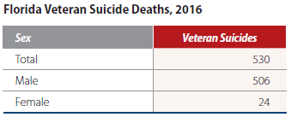
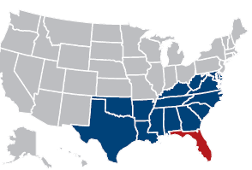
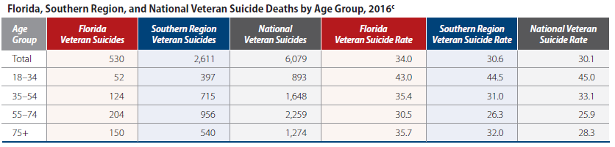
Florida Suicide Statistics, 2016

Slide 5
GCVHCS Suicide Prevention Program
Total of 5 staff: 2 Coordinators and 3 Case Managers
Where are we located?
Biloxi
Lynn Worley, LCSW, BCD – Lead Suicide Prevention Coordinator
Kirie Paddy, LCSW, BCD – Suicide Prevention Case Manager
Mobile
Rachel Mosley, LCSW – Suicide Prevention Case Manager
JACC, Pensacola, FL
Carrie Musselwhite, LCSW – Suicide Prevention Coordinator for CBOCs
Eglin
Angela VanNuck, LCSW – Part-time Suicide Prevention Case Manager

Slide 6
What Suicide Prevention is Doing to Help:
Identify High Risk Veterans, track appointments, and coordinate enhanced care
Coordination of care with Community and VA providers
On-going training to VA, Community Agencies, & Law Enforcement
Lethal Means Reduction
Outreach
VCL
REACH VET
Research Studies

Slide 7
Veterans Crisis Line
Veterans Crisis Line/Chat/Text
1-800-273-8255 and Press 1
VeteransCrisisLine.net
Text to 838255

Slide 8
Resources
Mental Health
VHA provides specialty inpatient and outpatient mental health services at its medical centers and community-based outpatient clinics. For more information on VA Mental Health Services, visit www.mentalhealth.va.gov
Vet Centers
Vet Centers are VA community-based centers that provide a range of counseling, outreach, and referral services. For more information about Vet Centers and to find the Vet Center closest to you, visit www.vetcenter.va.gov
Make The Connection
MakeTheConnection.net is a one-stop resource where Veterans and their families and friends can privately explore information about physical and mental health symptoms and learn about available resources and support. Visit MakeTheConnection.net to learn more.

Slide 9
How to Reach Us
Coordinators
Lynn Worley, LCSW, BCD
Lead SP Coordinator
Email: Lynn.Worley@va.gov
Phone: (228)523-4288
Location: Biloxi VAMC
Carrie Musselwhite, LCSW
SP Coordinator CBOCs
Email: Carrie.Musselwhite@va.gov
Phone: (850)912-2310
Location: JACC, Pensacola, FL
Case Managers
Kirie Paddy, LCSW, BCD
Email: kirie.paddy@va.gov
Phone: (228)523-2000 ext. 34167
Location: Biloxi VAMC
Rachel Mosley, LCSW
Email: Rachel.Lapointe2@va.gov
Phone: (251)219-3900 ext. 33838
Location: Mobile, AL CBOC
Angela Vannuck, LCSW (Part-time)
Email: Angela.Vannuck@va.gov
Phone: 850-609-2631
Location: Eglin AFB CBOC

